Slide 1
Testing Tools

Slide 2
Analyzing usability testing
Manual testing
Tools Testing
Online Testing

Slide 3
Tools testing
Using different tools.
For example :
Eye Tracking
Heat Maps

Slide 4
Eye Tracking
Eye tracking involves measuring either where the eye is focused or the motion of the eye as an individual views a application/websites.
trace the eye’s movement between areas of focus

Slide 5
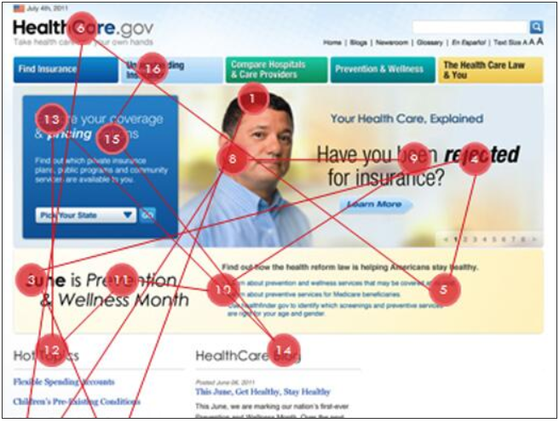
Eye Tracking

Slide 6
Heat Maps
Heat maps represent where the visitor concentrated their gaze and how long they gazed at a given point. Generally, a color scale moving from blue to red indicates the duration of focus. Thus, a red spot over an area of your page might indicate that a participant, or group of participants, focused on this part of a page for a longer period of time.

Slide 7
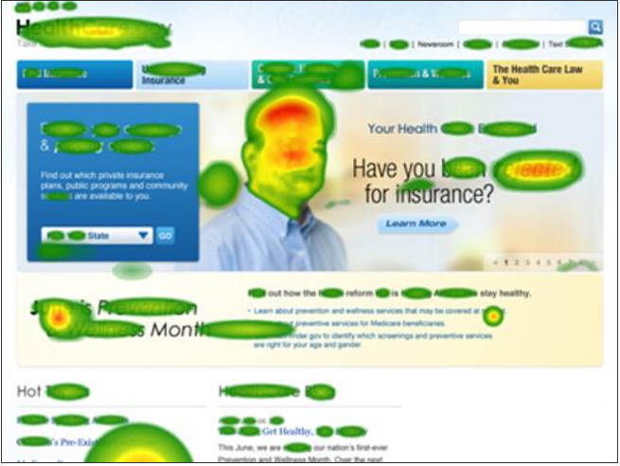
Heat Maps

Slide 8
2.Online testing
https://www.usertesting.com/
https://www.testbirds.com/

Slide 9
Manual Testing
Wizard of Oz

Slide 10
Wizard of OZ
In one form we shamelessly fool the participants into believing the system is doing something that it is not.
For example, Wizard of Oz testing was used in developing early speech recognition software.
User-based evaluation of unimplemented technology where, generally unknown to the user, a human or team is simulating some or all the responses of the system.

Slide 11
You can test future technologies without building an expensive prototype, or can "fill in" functionality that is not yet ready for a prototype.
Rapid iterations, particularly minor changes in wording or call flow, are immediately testable.
Allows the system to be evaluated at an early stage in the design process.
Provides a unique insight into the user's actions, gained from 'interacting' with the user during the evaluation.
Colleagues who play the "wizard" can learn about how users interact with computer systems.

Slide 12
Disadvantages
Wizard simulations require significant training so the wizard can respond in a way that is credible.
Involving and training a Wizard is an additional resource cost.
It is difficult for wizards to provide consistent responses across sessions.
Computers respond differently than humans so the wizard needs to match how a computer might respond
Playing the wizard can be exhausting, meaning the wizard's reaction may change over time, mainly due to cognitive fatigue.
It is difficult to evaluate systems with a large graphical interface element.
This approach does not uncover errors that arise as a result of system performance and recognition rates (unless these are specifically simulated), so it is more effective in revealing problems than predicting real world usability

Slide 13
Cost-Effectiveness
Wizard of Oz testing is a highly cost-effective way to compare multiple designs.

Slide 14
HOW TO?
The wizard sits in a back room, observes the user's actions, and simulates the system's responses in real-time.

Slide 15
The basic wizard of Oz procedure involves the following steps:
Develop a simulated user interface for the target technology.
Develop a detailed test plan with the instructions for the facilitator, wizard, participants and other staff. Determine if you need to set any expectations about the simulation's "performance" so participants are prepared for sub-par performance.
Recruit users who meet the appropriate user profile, try to cover the range of users within the target population.
Prepare realistic task scenarios for the evaluation.

Slide 16
The basic wizard of Oz procedure involves the following steps:
Develop a procedure where the wizard can respond to input from a participant.
Train the wizard.
Design the instructions for the study so that the participant knows that they are working with an early prototype and that performance is not "optimized" yet.
Conduct pilot tests to refine the procedure and give the wizard some practice. Make any changes to the procedures and test plan.
Ensure recording facilities are available and functioning.

Slide 17
The basic wizard of Oz procedure involves the following steps:
Conduct each session. The facilitator instructs the user to work through the allocated tasks interacting and responding to the system as appropriate.
Conduct a debriefing of the participants. Obtain feedback on the "performance of the wizard system". Tell the users about the wizard and explain why you couldn't tell them earlier.
Collate, analyze, and summarize the data from the study. Consider the themes and severity of the problems identified.
Summarise design implications and recommendations for improvements and feed back to design team. Video recordings can support this.
Where necessary refine the prototype and repeat the above process.

Slide 18
Example :
https://www.youtube.com/watch?v=6dre0P4tRTc

Slide 19
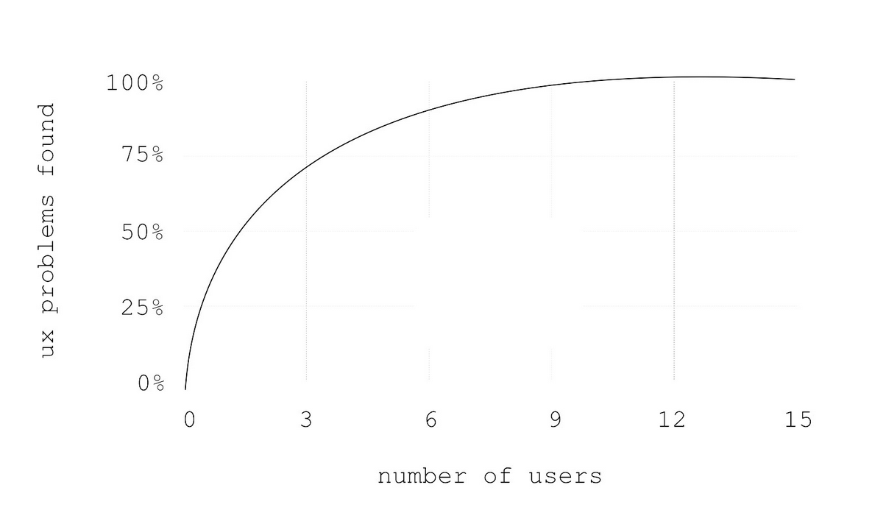
Number of users - 5

Slide 20
Setup
Find a neutral and quiet testing environment with a table and chairs, so that you can fit it all your participants.
Apart from the tester, a session requires at least two more people:
Person number one is the facilitator, that instructs users and interacts with them.
Person number two is «the computer». This person doesn’t talk during the session and is in charge of changing screens or screen states, whenever the user interacts with your prototype.
There might be a third person scribing, and other people observing.

Slide 21
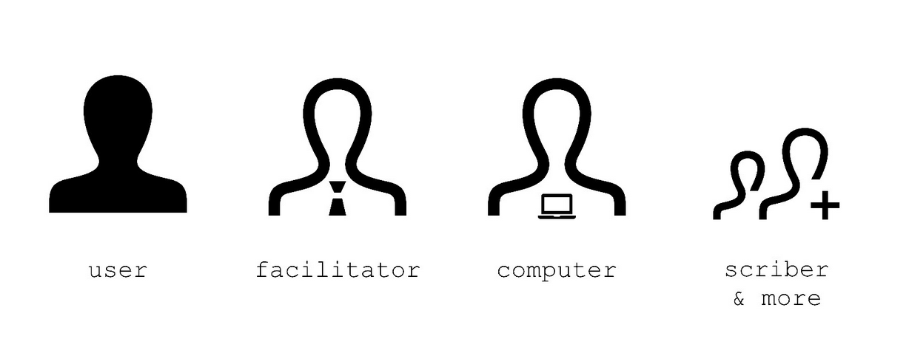
User SETUP

Slide 22
Prototype Screen
Apart from the human resources, you obviously need your prototype screens. Rather than just placing them on a table, have a mockup of your device ready.
This may just be a piece of paper, larger than your drawings, and showing a frame printed or drawn onto it. This will be the device where you place your interfaces on.

Slide 23
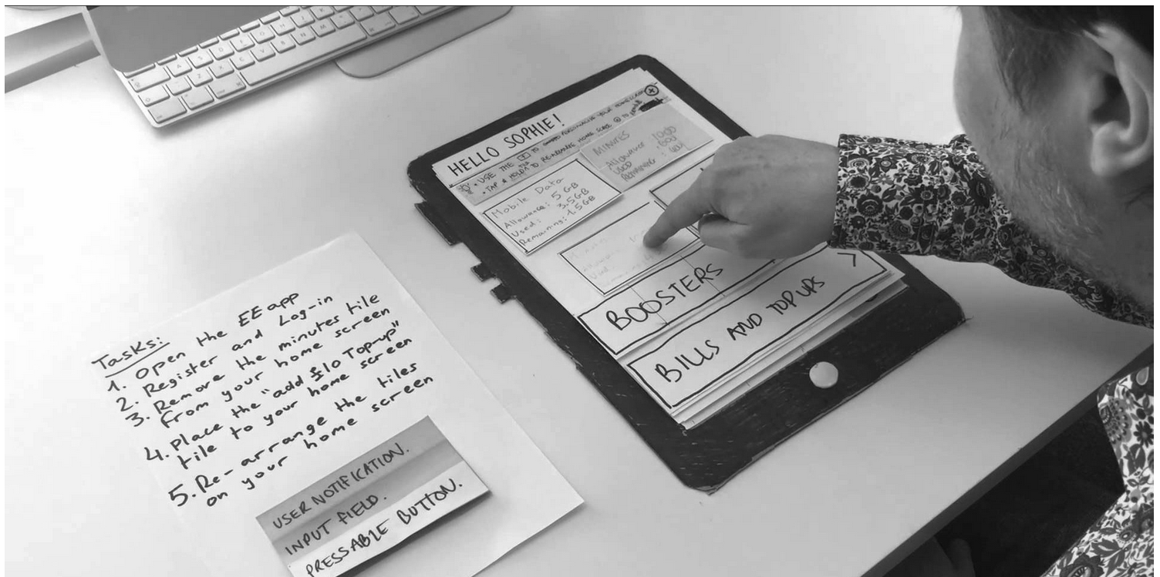
Example

Slide 24
Conduction a testing session
Testing sessions need to be well planned and well conducted.
Start off with greeting your users and introduce them to yourself, the computer and other people in the room.
Clearly explain the testing scenario and how the paper prototype works.
Tell users that you are testing a potential system and not them. Let them know, that they can’t do anything wrong.

Slide 25
Conduction a testing session
Furthermore instruct them to verbally state their thoughts and thinking process, whilst interacting with the prototype.
Once the general introduction is done, introduce them to the task.
In order to get them interactive, show hand them the testing script and make them read it out loud.
The script consists of the persona the user is playing, the scenario and the task. Make sure that users understand what you expect from them and start the test.

Slide 26
Observation
Observe closely, how the they perform, and what kind of reactions and feedbacks you get. Do not interrupt or question.
Talk as little as possible. If the users gets stuck, let them find a way out and wait until they questions you.
Respond as little as possible — or at least wait until the end of the session — ask open questions instead, such as: «How did you feel», «What did you expect»

Slide 27
Consent Form
A Consent Form gives written permission to another party that they understand the terms of an event or activity that will be performed

